Slide 1


Outline
1
01
A definition of cellular deconvolution
2
02
Standard deconvolution
3
03
DeCovarT framework
4
04
Numerical simulations
5
Deconvolution pipeline
(if enough time or questions)
05

Slide 2

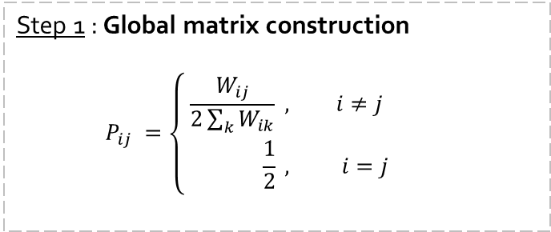

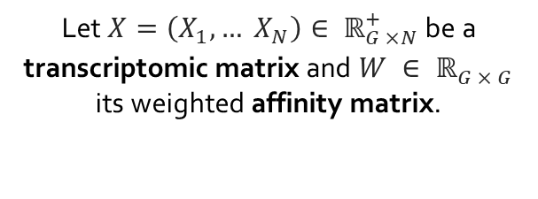


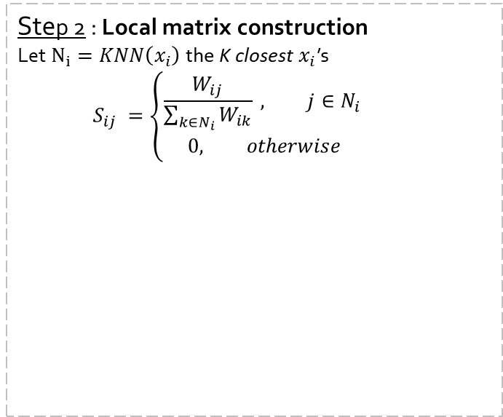

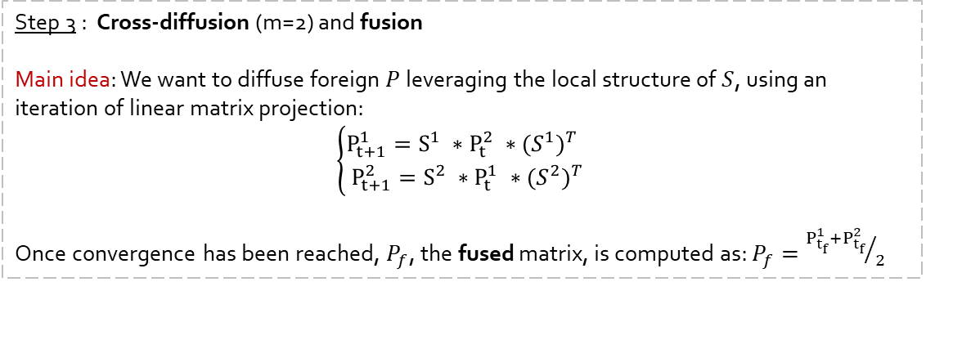

Step 2 : Local matrix construction
Let $N_{i}=KNN\left(x_{i}\right)$ the K closest $x_{i}$’s
$$S_{ij} =\left\{\begin{aligned}\frac{W_{ij}}{\sum_{k∈N_{i}}{W_{ik}}} , j∈N_{i} \\ 0, otherwise\end{aligned}\right.$$
Dataset 1
Dataset 2
$$P^{1}=P_{0}^{1}$$
$$P^{2}=P_{0}^{2}$$
Let $X=\left(X_{1}, … X_{N}\right)∈ ℝ_{G ×N}^{+}$ be a transcriptomic matrix and $W ∈ ℝ_{G × G}^{}$ its weighted affinity matrix.
$$W^{1}$$
Global matrix
$$W^{2}$$
Global matrix
Original affinity
matrix
$$S^{1}$$
Original affinity
matrix
$$S^{2}$$
Local matrix
Local matrix
Step 1 : Global matrix construction
$$P_{ij} =\left\{\begin{aligned}\frac{W_{ij}}{2\sum_{k}{W_{ik}}} , i≠j \\ \frac{1}{2} , i=j\end{aligned}\right.$$
Step 3 : Cross-diffusion (m=2) and fusion
Main idea: We want to diffuse foreign $P$ leveraging the local structure of $S$, using an iteration of linear matrix projection:
$$\left\{\begin{aligned}P_{t+1}^{1}=S^{1} ∗P_{t}^{2} ∗{{(S}^{1})}^{T} \\ P_{t+1}^{2}=S^{2} ∗P_{t}^{1} ∗{{(S}^{2})}^{T}\end{aligned}\right.$$
Once convergence has been reached, $P_{f}$, the fused matrix, is computed as: $P_{f}={P_{t_{f}}^{1}+P_{t_{f}}^{2}}/2$

Slide 5


Slide 6
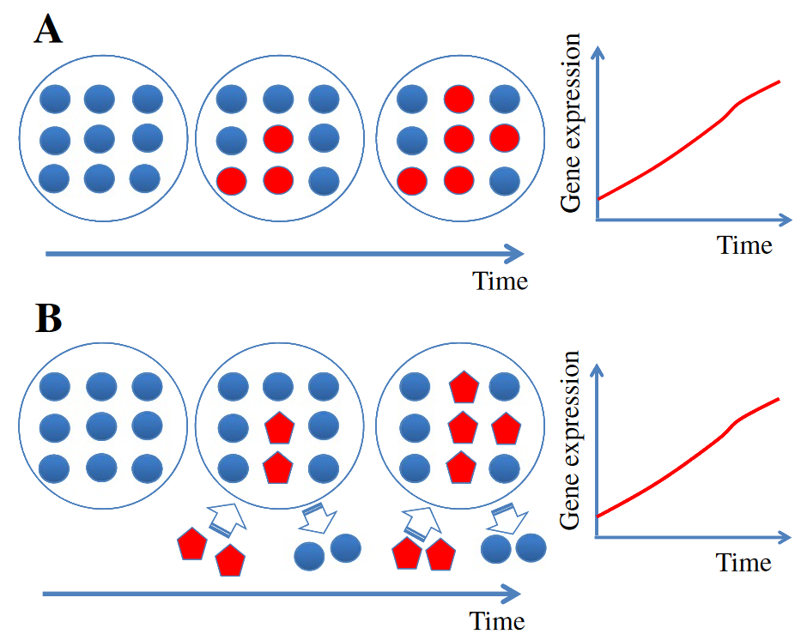
Confusing biological noise
A definition of cellular deconvolution
resting cell population 1
activated cell population 1
activated cell population 2
Shoemaker et al. 2012c
Scenario A: increase of the gene expression is generated by an activation of cell population 1
Scenario B: the gene expression increases due to the arrival of a new cell population 2

